Slide 1
Validation Room
User Stories

Slide 2
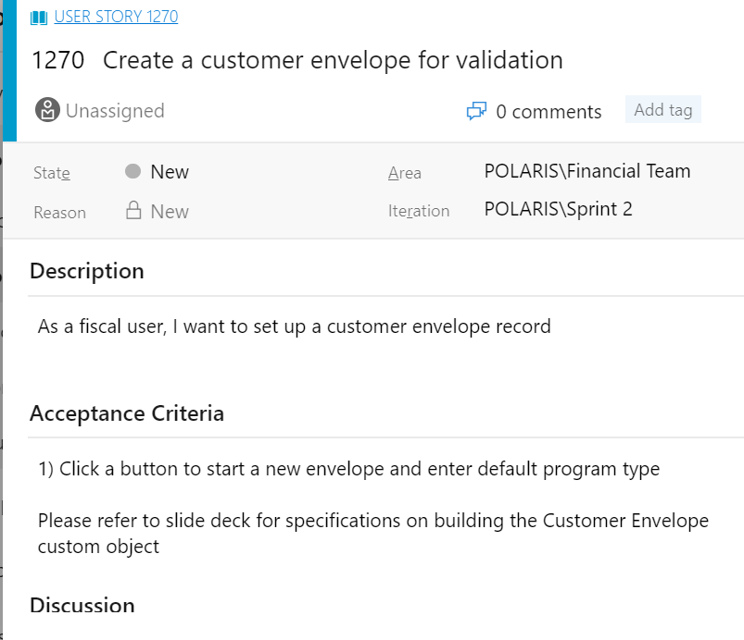
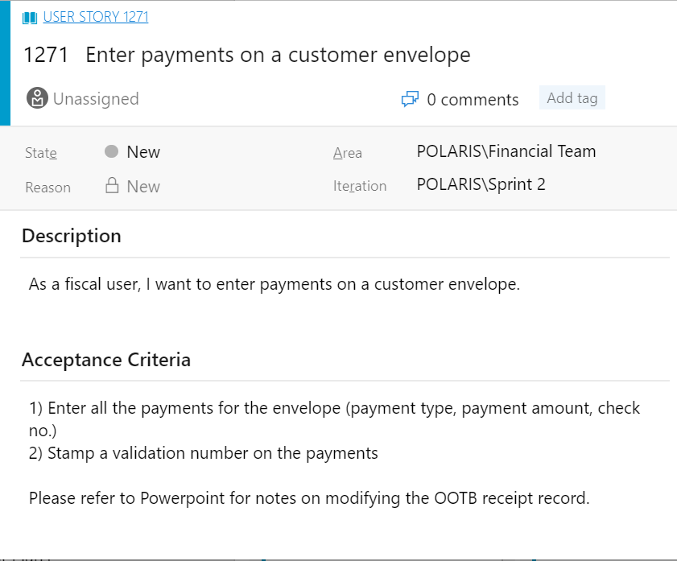
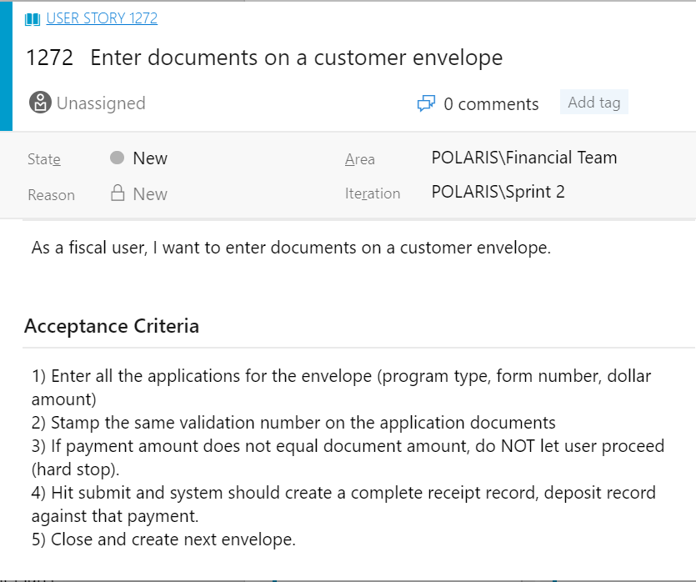
3 User Stories

Slide 3
1) Customer Envelope Object
Fields:
Validation number (system generated 9 digit number: xxxxxxxxx)
Default program type (picklist)
Funerals, cemeteries, engineers, land surveyors, on-site wastewater, collection agencies, geologists, architects, landscape architects, camping resorts, appraisers-real estate, timeshares, notaries public, appraisal management companies
Date (system generated)
Total amount (currency)
Number of payments (number)
Number of documents ( number)
Unprocessed documents (number)
Status (picklist: draft, pending, processed)

Slide 4
Receipt Object
This is an OOTB BG object, but we (might) need to create the following fields:
Fields:
Sequence number (number)
Payment type (picklist: cash, check, money order, voucher)
Date (system-gen)
Payment Number (text)
Payment amount (currency)
Validation number (lookup to ‘Customer Envelope’ object)

Slide 5
Deposit Object
This is an OOTB BG object, but we (might) need to create the following fields:
Fields:
Sequence number (number)
Program type (picklist: Funerals, cemeteries, engineers, land surveyors, on-site wastewater, collection agencies, geologists, architects, landscape architects, camping resorts, appraisers-real estate, timeshares, notaries public, appraisal management companies)
Form number (picklist: For now, please use the following – BC-638-151, DS-232-232, OP-232-543, AS-620-209)
Amount (currency)
Date (system-generated)
Validation number (lookup to ‘Customer Envelope’ object)
Status (picklist: pending, completed)
License (lookup to the License)
Professional code (free text)
License type (picklist: {Nazneen -- Can you please use your existing list of license types?} )
Document type (picklist: original ,renewal, maintenance request, misc)
Contact name (search or create)
Business name (UBI code – there is an integration with the Secretary of State)

Slide 6
General Flow
As a fiscal user,
1) Click a button to start a new envelope and enter default program type
2) Enter all the payments for the envelope (payment type, payment amount, check no.)
3) Stamp a validation number on the payments
4) Enter all the applications for the envelope (program type, form number, dollar amount)
5) Stamp the same validation number on the application documents
6) If payment amount does not equal document amount, do NOT let user proceed (hard stop).
7) Hit submit and system should create a receipt record, deposit record, and shell application against that payment.
8) Close and create next envelope.

Slide 7
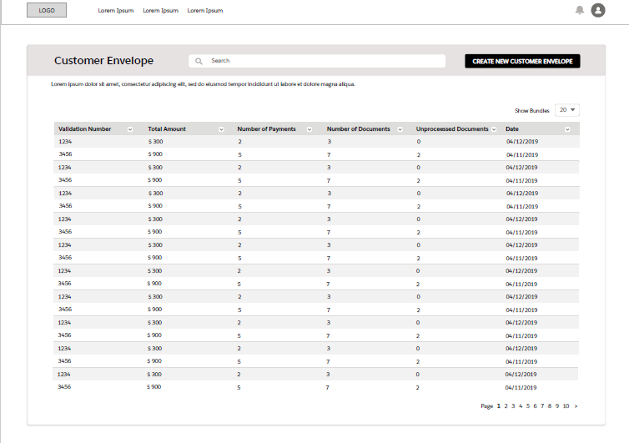
UI and Logic
Button to create new record
Logic:
This is a list view of all the different customer envelopes. Validation number is the unique identifier of the customer envelope.

Slide 8
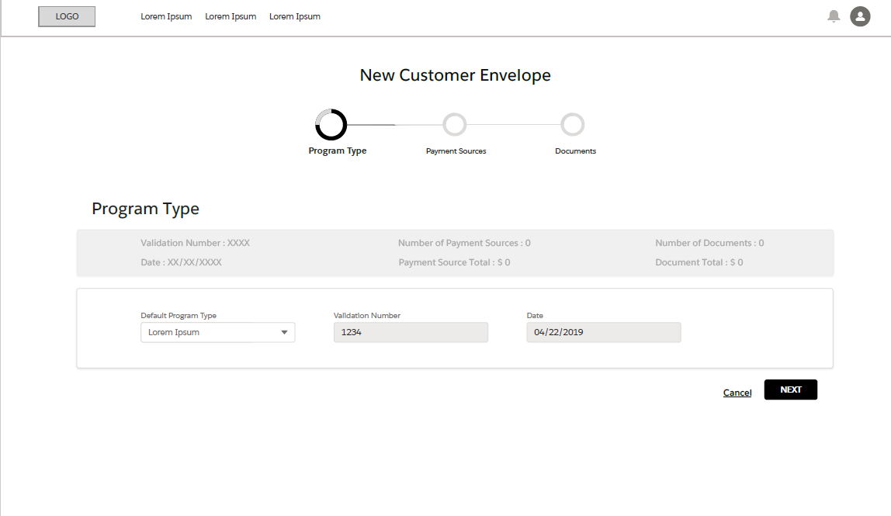
UI and Logic
Logic: Set up your customer envelope
Breadcrumbs/chevrons to walk accountant through the process
A running header with read-only info
Default program type picklist
Read-only validation number
Read-only date
1
2
3
4
5

Slide 9
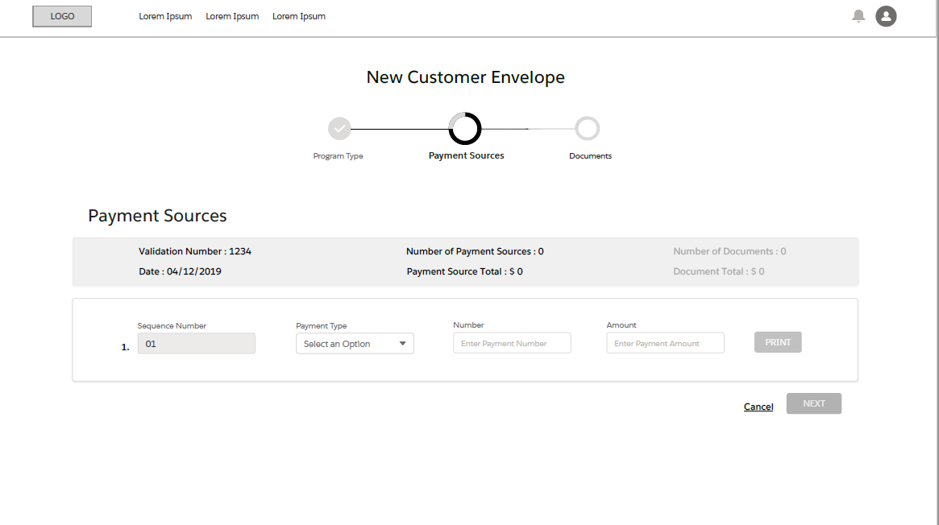
UI and Logic
Logic: Enter payment sources
Breadcrumb/chevron now highlights the second tab
Number of payment source total updates every time a user hits ‘print’
Number of documents/doc total are greyed out since no docs are entered yet
Sequence number is system generated and starts at 001
Payment type is a picklist
Payment Number is a free text field (should not be just ‘number’)
Amount is the check amount
“print” and “next” are disabled since no data has been entered
1
2
3
8
4
5
6
7

Slide 10
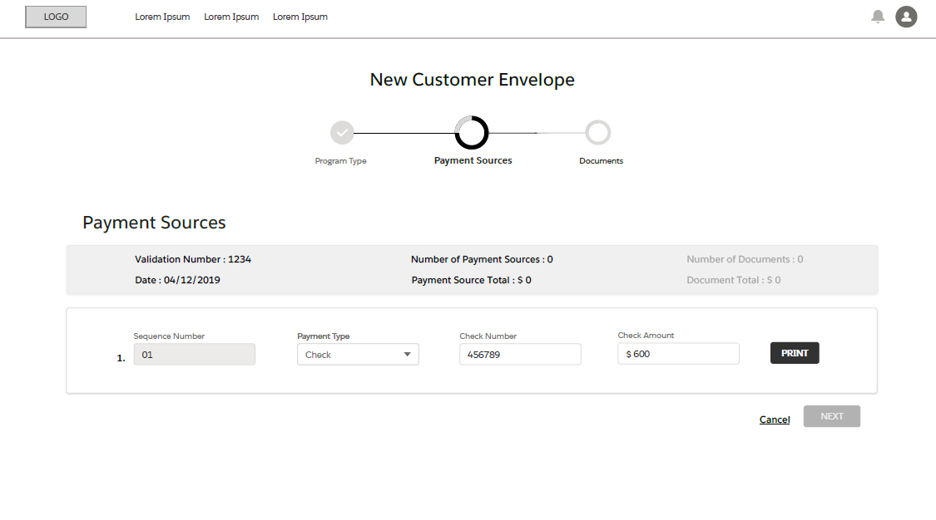
UI and Logic
Logic:
Button is now enabled since the user has entered data in all three fields.
1

Slide 11
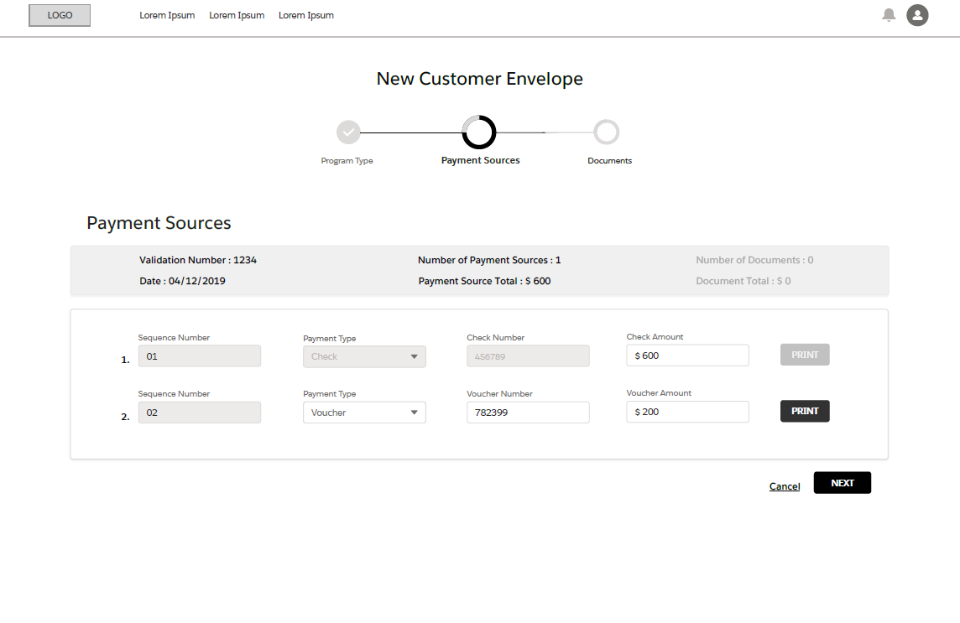
UI and Logic
Logic:
3 things happen when a user hits print:
A new row appears beneath
The Number of Payment sources and Payment Source Type are updated in the header
A stamp prints the validation number on the back of the check
1
Just FYI: Printing Process
Upon hitting “print,” there is a physical stamp printer that stamps the validation number, sequence number, and date on the back of the check and application (application stamp occurs on the next page).

Slide 12
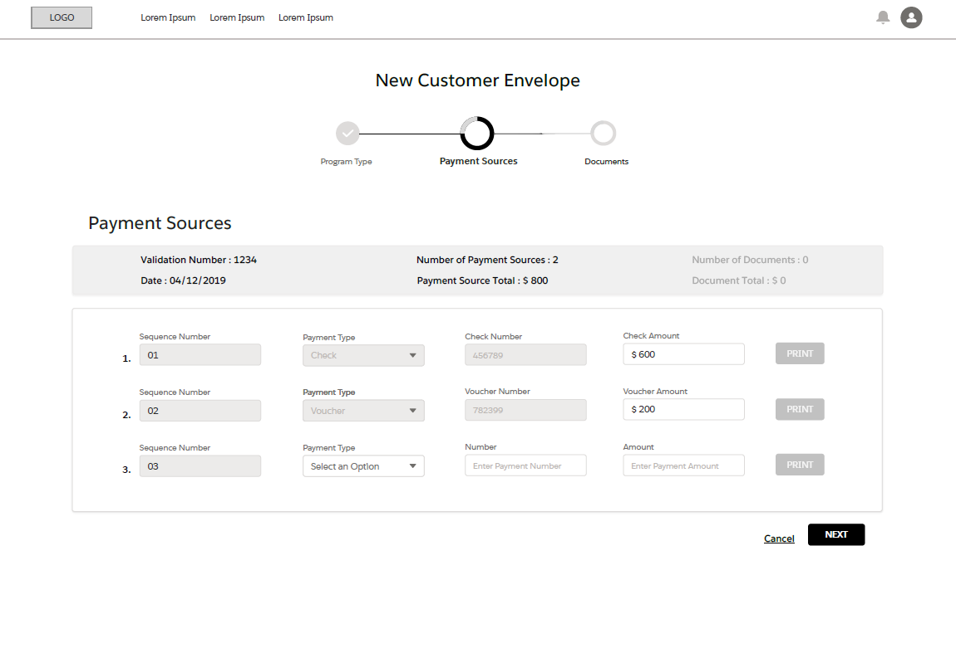
UI and Logic
Logic:
New row inputted
1

Slide 13
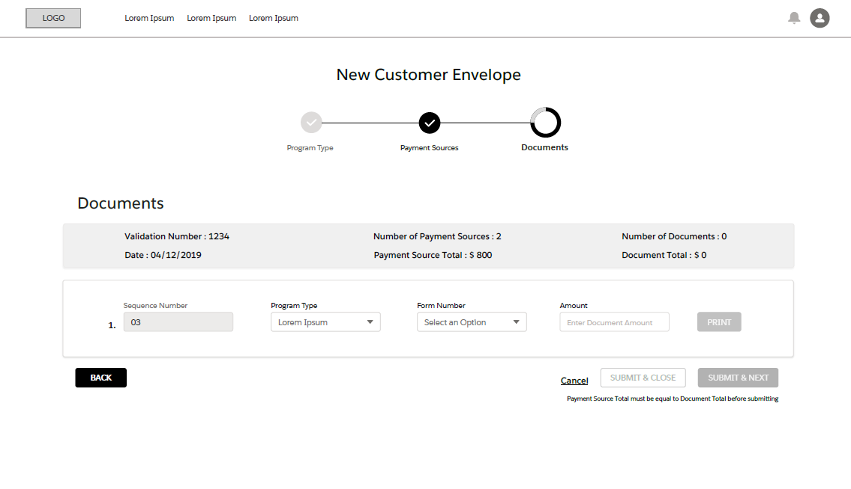
UI and Logic
Logic:
Chevron is updated
The payment sources and payment source total are updated.
Back button goes to the last chevron
Program type is filled out with the default program type. However, user can change it if need be. Also, picklist values are determined by the program type
Submit buttons are disabled since the documents total do not match the payment source total
1
2
4
3
5

Slide 14
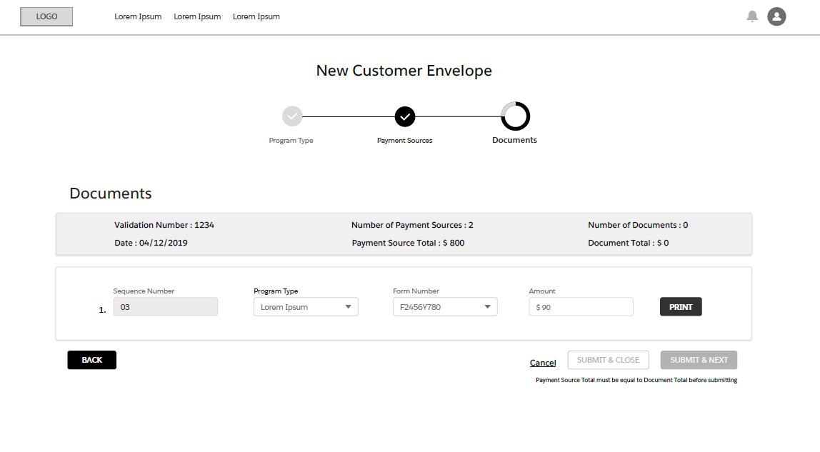
UI and Logic
Logic:
Print button is now enabled since the three fields are filled out
The submit button is still disabled since the payment source total does not equal the number of documents.
The amount will auto-populate as the payment source total (this case, $800)
1
3
2

Slide 15
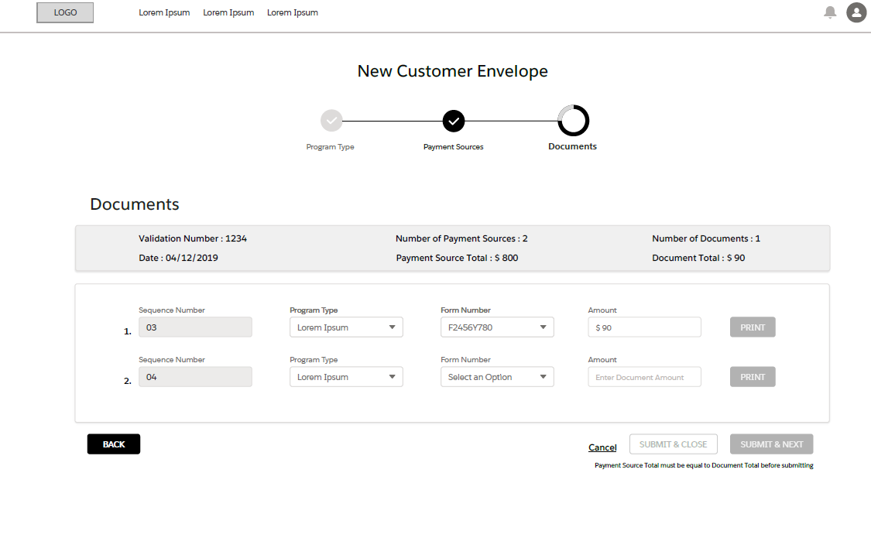
UI and Logic
Logic:
document total updates upon “print”
The new amount would default as $710 (source total – what has already been entered)
Submit button is grey since source total =! Document total
1
2
3

Slide 16
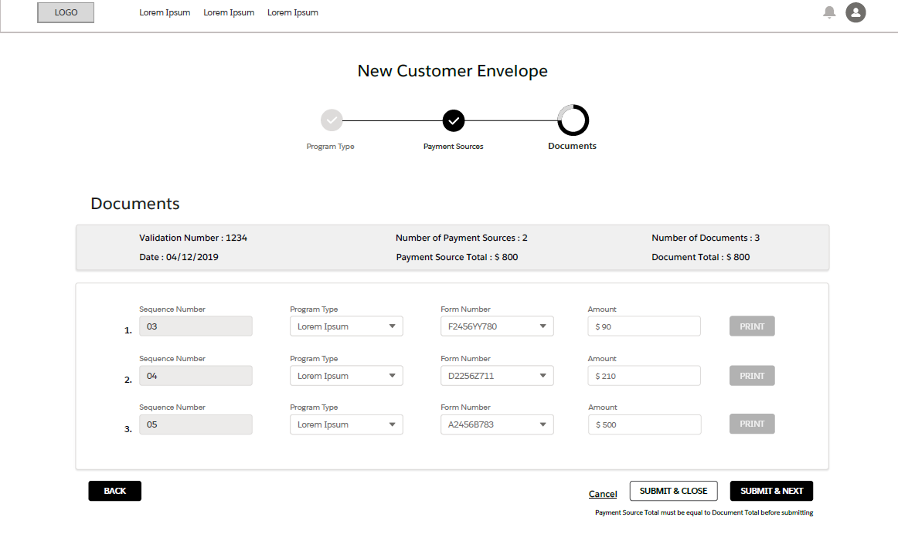
UI and Logic
Logic:
Payment total = document total; which is why the ‘submit’ button is now enabled
Submit & next takes the user to a new customer envelope program type page; submit and close takes user back to list view
‘back’ button takes user to the payment sources page
1
2
3

Slide 17
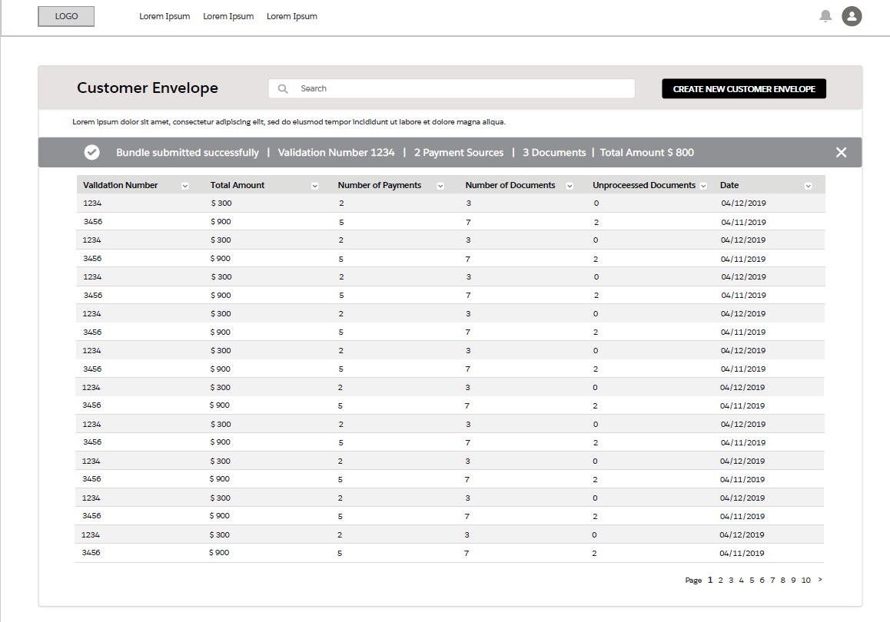
UI and Logic
Logic:
Confirmation banner shows up temporarily
This shows up even if the user selected “submit and next”
1

